Slide 1
Zowe “vNext” – 2.0 Early Roadmap
Notes:
Opening Slide

Slide 2
Agenda
Zowe 1.x – Where we are today
Architecture
Milestones in Zowe 1.x
Installation, Configuration, and Maintenance
Zowe 2.0 – “vNext”
Overview
Deeper Dive - Install
Breaking Changes
Engagement
Contributing to Zowe 2.0
Notes:
Goal:
-Set context of 1.0’s current state, positives and negatives
-Talk about Zowe 2.0’s broad-brush priorities, and some practical methodology around it
-Encourage people to get engaged and influence our priorities/goals.

Slide 3
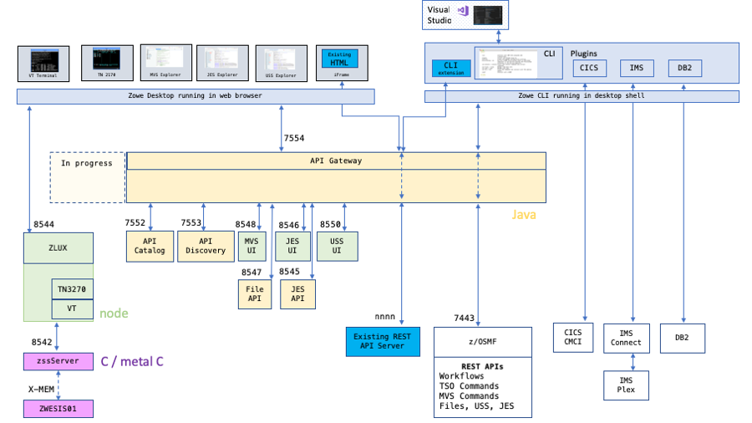
Zowe 1.x Architecture
Notes:
Topic: Compared to Beta versions of Zowe, we have improved integration between the individual components in the Zowe framework….and Added more Plug-ins / APIs.

Slide 4
Zowe 1.x Milestones
API Mediation Layer
Swagger Doc
HTTPS Support
SSO using z/OSMF
Application Framework
Internationalization/Settings
App2App for iFrames
Enhanced Explorer Applications
Open Source ZSS Server
CLI
z/OSMF Workflow Support
VSCode Plugin Enhancements, DB2, IMS, CICS, and MQ CLI Plug-ins
Public NPM Registry Deployment
Project-Wide
Improved Installer and Scripts
Improved Documentation
Improved Security reporting and remediation process
Improved integration amongst the various Zowe components.
Conformance v1 and Enabler Libraries
Enhanced Build/Test/Deploy Pipelines
All Zowe components Open Source and EPL-2.0.
Core Infrastructure Initiative Badge – Passing!

Slide 5
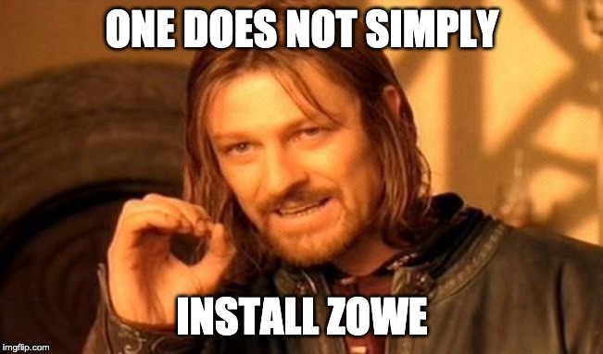
Installation, Configuration, and Maintenance
One point of resounding feedback from Zowe 1.x was the install experience
In an image:
Notes:
Add animation

Slide 6
Zowe – What’s Next?
So what are we thinking about going into Zowe 2.0?
Disclaimer: Zowe 2.0 scope is not finalized. Some items may drop and others added – your feedback matters and influences our priorities!
Our Areas of Interest:
Installation refactor to an SMP/e based delivery.
Facilitating Long Term Support by both the Open Community and/or enterprise support providers.
Zowe Application Directory / Marketplace
Re-writing some of our extender/enabler libraries
Standardize Logging Strategy
Migrating our build/test/deploy to (mostly) open infrastructure and public registries
Further improving integration between framework components
Sysplex-Enablement and High Availability
Dynamics / Discovery
Additional Applications/Extensions built on Zowe which demonstrate framework value and capabilities
MFA
…and more
Notes:
Should we include security ? Do we have any definitive priorities for 2.0 related to security?
Anything else missing?
Talk briefly about each area of interest?

Slide 7
Deeper Dive - Installation
What exactly is changing to improve the installation experience?
We are converting our installation to use SMP/e, thus aligning us with more traditional mainframe practices.
There will be a single FMID (AZWE001) for Zowe.
This SMP/e PAX will be available both on zowe.org and redistributed by vendors.
An alpha version may be available shortly! Configuration at launch will be absent in the early alpha versions.
Security configuration visible through JCL, rather than configured manually in YAML on USS and executed through shell scripts.
SMP/e will allow us to deliver fixes and updates in standardized ways.
PTFs, HOLDDATA, etc.
Details are in progress, comment if you have an opinion!
Back off some usage of z/OS Security definitions (IZUSVR, IZUADM, etc.)
Notes:
Key point: Alignment with normal/standard practices on the mainframe as a pre-requisite to other initiatives like Long Term Release support.

Slide 8
Zowe 2.0 - About Breaking Changes
Our take on breaking changes
Mainframe historically has breaking changes very rarely – backwards compatibility is a key tenet of the software and platform.
Distributed software and modern development, by comparison, break frequently.
Our Goal: Break infrequently, maintain backwards compatibility wherever feasible and exhaust all options – but we will accept breakage at times.
We believe necessary breakage will diminish over time as the framework matures
Expect breakage on major version boundaries – e.g. 1.x, 2.x, 3.x. Any build within a major version will not break, but may have new features.
See Semantic Version for more information: https://semver.org
Notes:
Establish some baseline expectations around breaking changes in Zowe, why & when

Slide 9
Zowe 2.0 – Breaking Changes
What kind of breaking changes can you expect in Zowe 2.0?
So far, our breakage will be mostly for Zowe extenders as we enhance the core frameworks and refactor coordinates/ids to match open standards (i.e., org.zowe) .
Installation refactor to SMP/e may result in some breakage, but currently we are 1.x compatible.
Other installation enhancements may also result in breakage
APIML Enabler Libraries will be refactored.
APIML 1.x Enabler Libraries may not work with Zowe 2.x, but consumers should be able to migrate to the 2.x Libraries without breakage.
Please subscribe to the zowe-dev and zowe-user mailing lists to receive updates on this effort and influence the outcome!
Zowe CLI changed some internal package names to align with Zowe, so plug-ins will need to refactor their library imports.
These changes are already available by building against the CLI’s `@latest` NPM tag.
Zowe Application Framework API & URL Namespace modifications
Revisit any unauthenticated APIs and make them authenticated or semi-authenticated as necessary
Notes:
Our public APIs constitute extenders, plug-ins, and a small suite of REST APIs through the gateway, explorers, and zss/zlux. Majority of breakage is in the extender/plug-in APIs, while there may be some small breakage of REST APIs. We do have versioning prefixes built into some REST APIs which can prevent breakage.

Slide 10

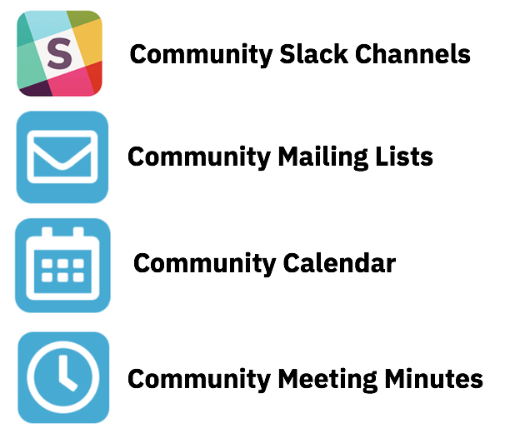
Getting Involved with Zowe!
Project Community site
https://zowe. org
Zowe “vNext” Roadmap
https://github.com/zowe/zlc/blob/master/tracking/Roadmap.md
Access to Zowe Convenience Deliverables
https://zowe.org/download
Review Zowe squads, missions and activities
https://zowe.org/contribute/
Project Governance
https://zowe.org/about-us/
GitHub
https://github.com/zowe
Project Documentation (includes user and install guides)
https://zowe.github.io/docs-site/
Developer Tutorials
https://zowe.github.io/docs-site/guides/intro.html
https://developer.ibm.com/tutorials/zowe-step-by-step-tutorial/
Notes:
Engagement slide -

Slide 11



Get involved in the Zowe community
Join Open Source Community @ https://www.openmainframeproject.org/projects/zowe
PROJECTS
Participate in and contribute to the Zowe developer community at zowe.org
Learn how your organization can become a steward and supporter of this project with Open Mainframe Project membership at openmainframeproject.org/about/join
DEVELOPER
COMMUNITY
PLATFORM
PARTICIPATION
Ecosystem
PROFITS
PRODUCTS
PROMOTION
SOFTWARE
Notes:
Closing slide

